Slide 1
Numerical Analysis of Settlement-Induced Bending Moments in Batter Piles
Alex Reeb, PhD, Burns Cooley Dennis, Inc.
George Filz, PhD, Virginia Polytechnic Institute and State University
Sponsors:
USACE
Via Foundation
NSF IGERT
Notes:
The main sponsor was the USACE, and they’ve played a role in directing the focus areas of this research.
IGERT, “Integrative Graduate Education and Research Traineeship”

Slide 2
Outline
Background
Centrifuge Tests
Numerical Modeling
Comparison of Centrifuge and Numerical Model Results
Summary

Slide 3
Background
FHWA driven pile manual states,
“Battered piles should be avoided in soil conditions where large soil settlements are expected because of the additional bending forces imposed on the piles which can cause pile deformation and damage.”
However, battered piles are required in some designs to resist large lateral loads and reduce horizontal deflections:
Pile-supported T-walls
Bridge abutments
Retaining walls
Wharfs

Slide 4
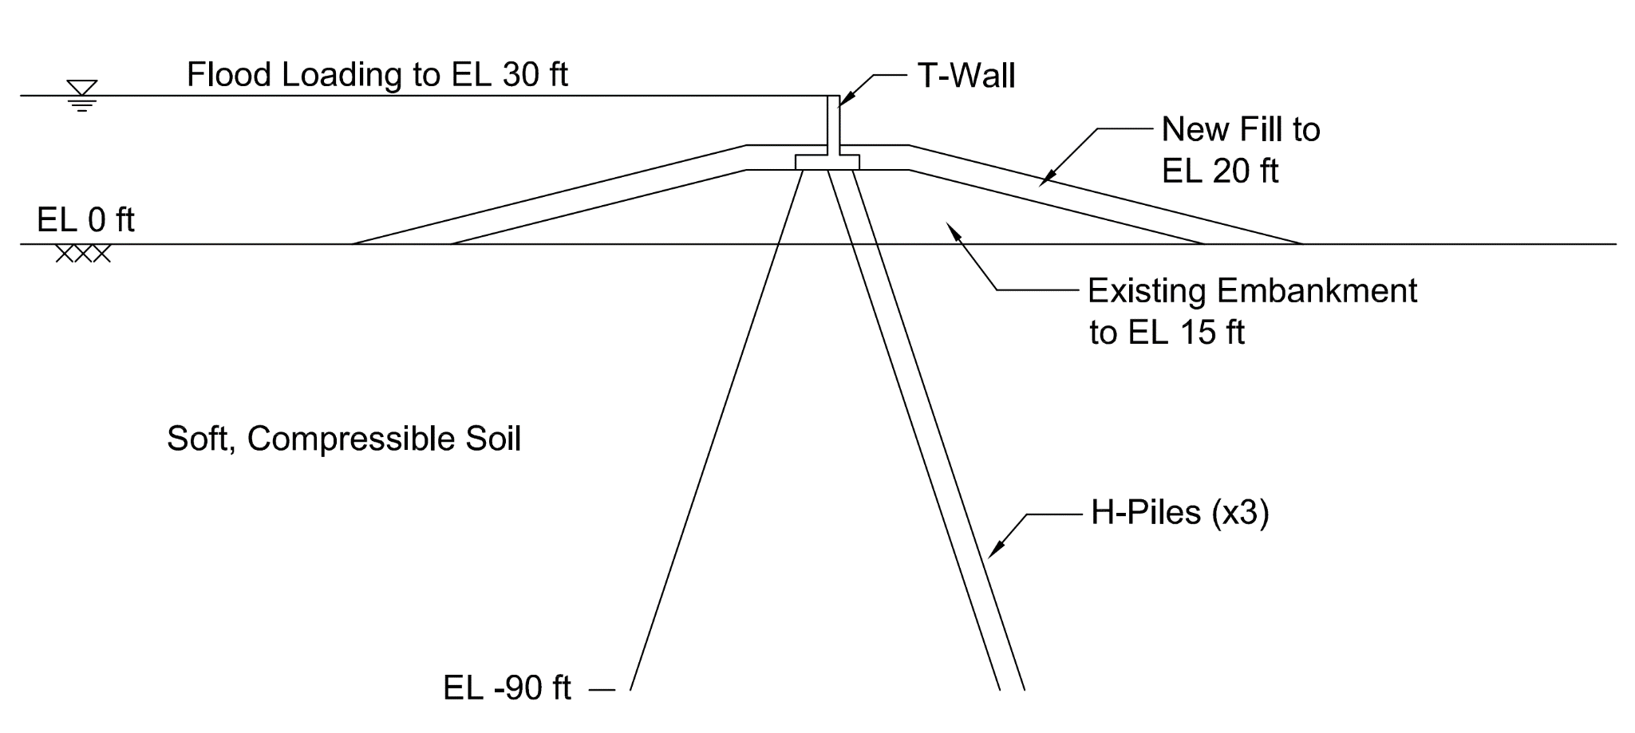
T-Wall Cross Section
Notes:
Here’s a simple representation of a T-wall cross section. T-wall on an existing embankment overlaying soft soils. Two piles batter toward PS and one towards FS. New fill was placed at the time the T-wall was constructed. This causes settlement, that applies a load acting normal to the piles and induces bending. And the resulting pile bending moments are a key design consideration.
In addition, you have to design for the effects of the flood loading, and the influence this flood loading will have on pile bending moments.
“Great Wall of St. Bernard” – 23 miles of floodwalls and gates

Slide 5
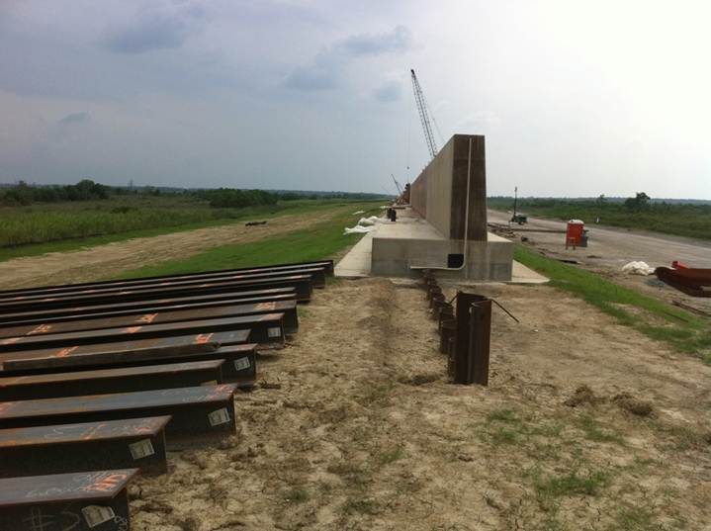
Notes:
T-wall under construction

Slide 6
Centrifuge Tests
Performed by Rensselaer Polytechnic Institute (RPI)
Investigated settlement-induced bending moments
Modeled eight T-wall cross sections
Tested influence of several different parameters:
Two vs. three piles
T-wall on foundation soils vs. on top of new levee
Symmetric vs. asymmetric new fill
Fill of broad vs. limited lateral extent
Pile spacing
Applied fill loading in two increments to produce multiple data sets for each test (8x2=16 total)
Notes:
The purpose of he centrifuge tests was to investigate SIBM.
Modeled eight different T-wall cross sections to test the influence of several different parameters, including….
Pile spacing, is the spacing of the piles along the T-wall and levee alignment.
Also, the fill loading was applied in increments to produce multiple data points for each test.

Slide 7
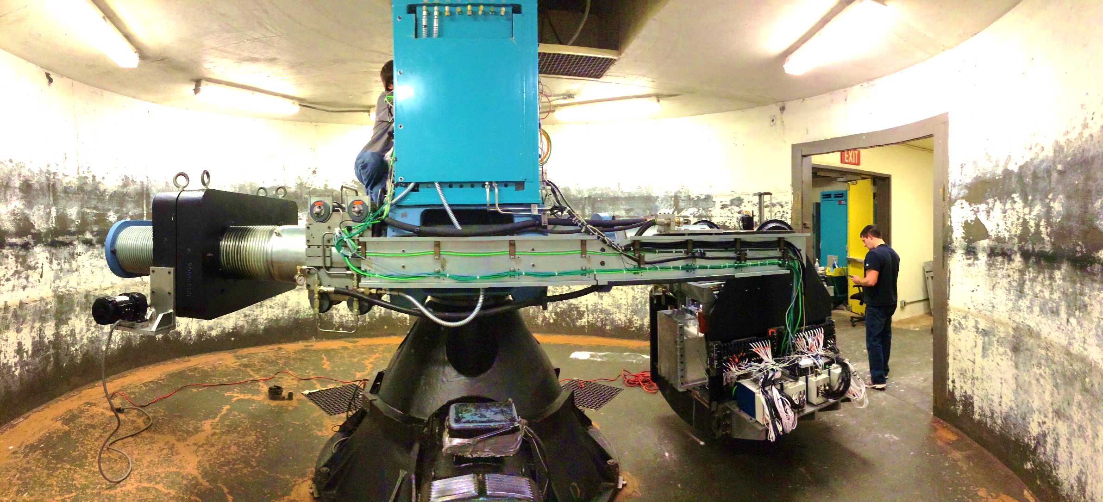
Centrifuge
Notes:
Here’s a picture of RPI’s centrifuge
3.0 m radius, is the distance between the swinging basket platform and the centrifuge axis
160 g, 1.5 tons, and 150 g-tons (product of payload weight times g)

Slide 8
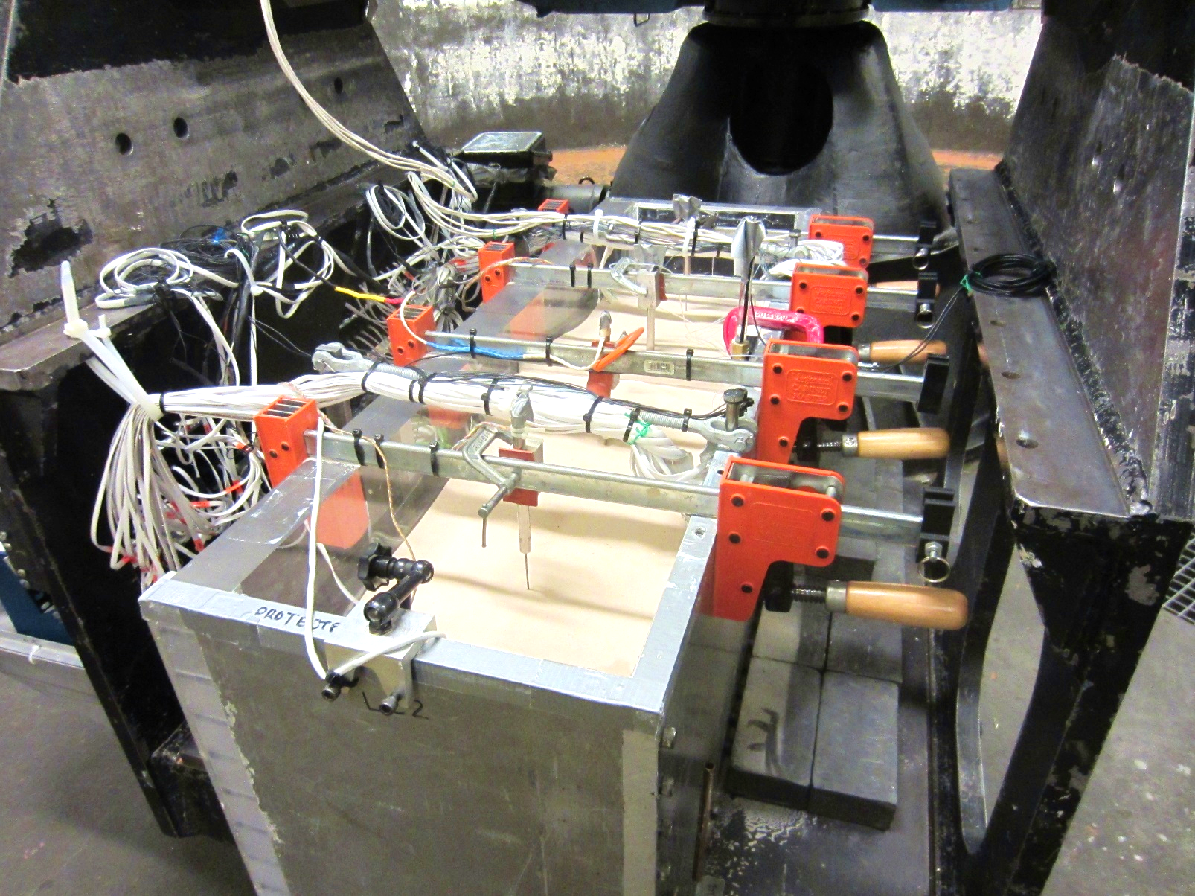
T-Wall Test Box
Notes:
Here’s a picture of the test box and one of the T-wall models.
You can see wiring for all of the instrumentation, which included strain gauges, pore pressure transducers, LVDT’s to measure surface settlement, and more
Note that the side of the box is clear acrylic

Slide 9
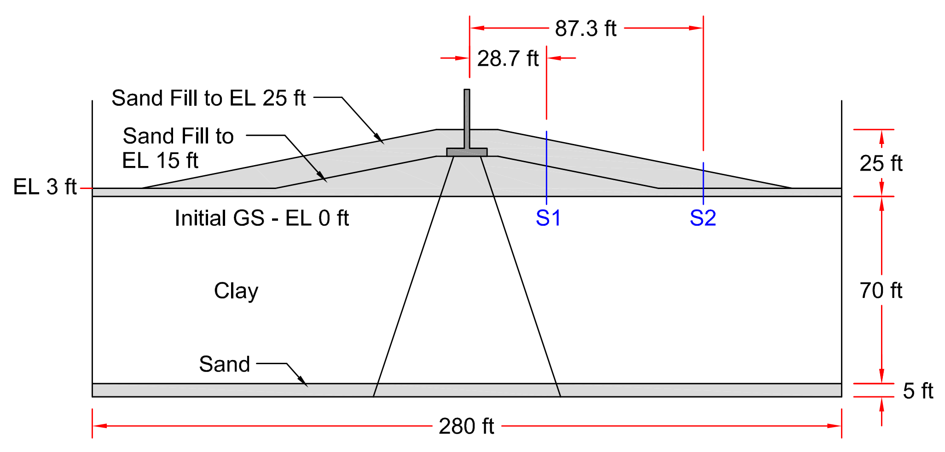
Run 2
Notes:
Show T-wall on top of new levee, 2 piles, fixed connections, settlement

Slide 10
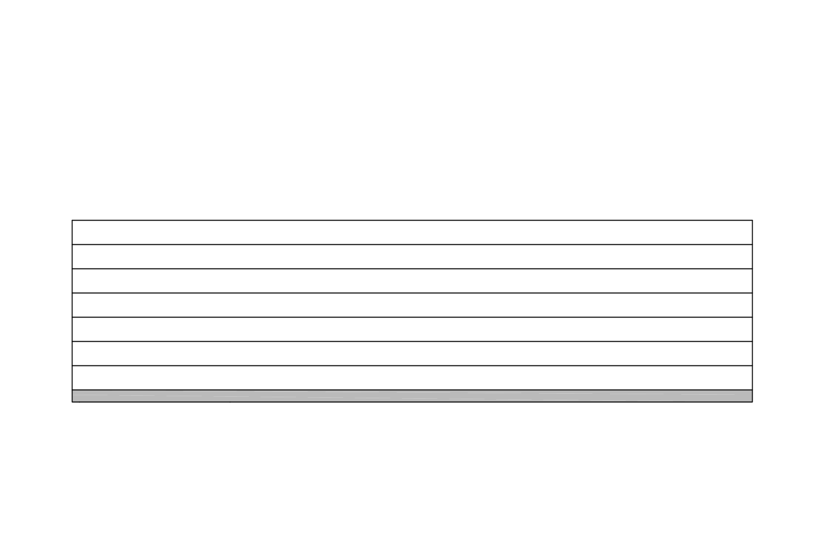
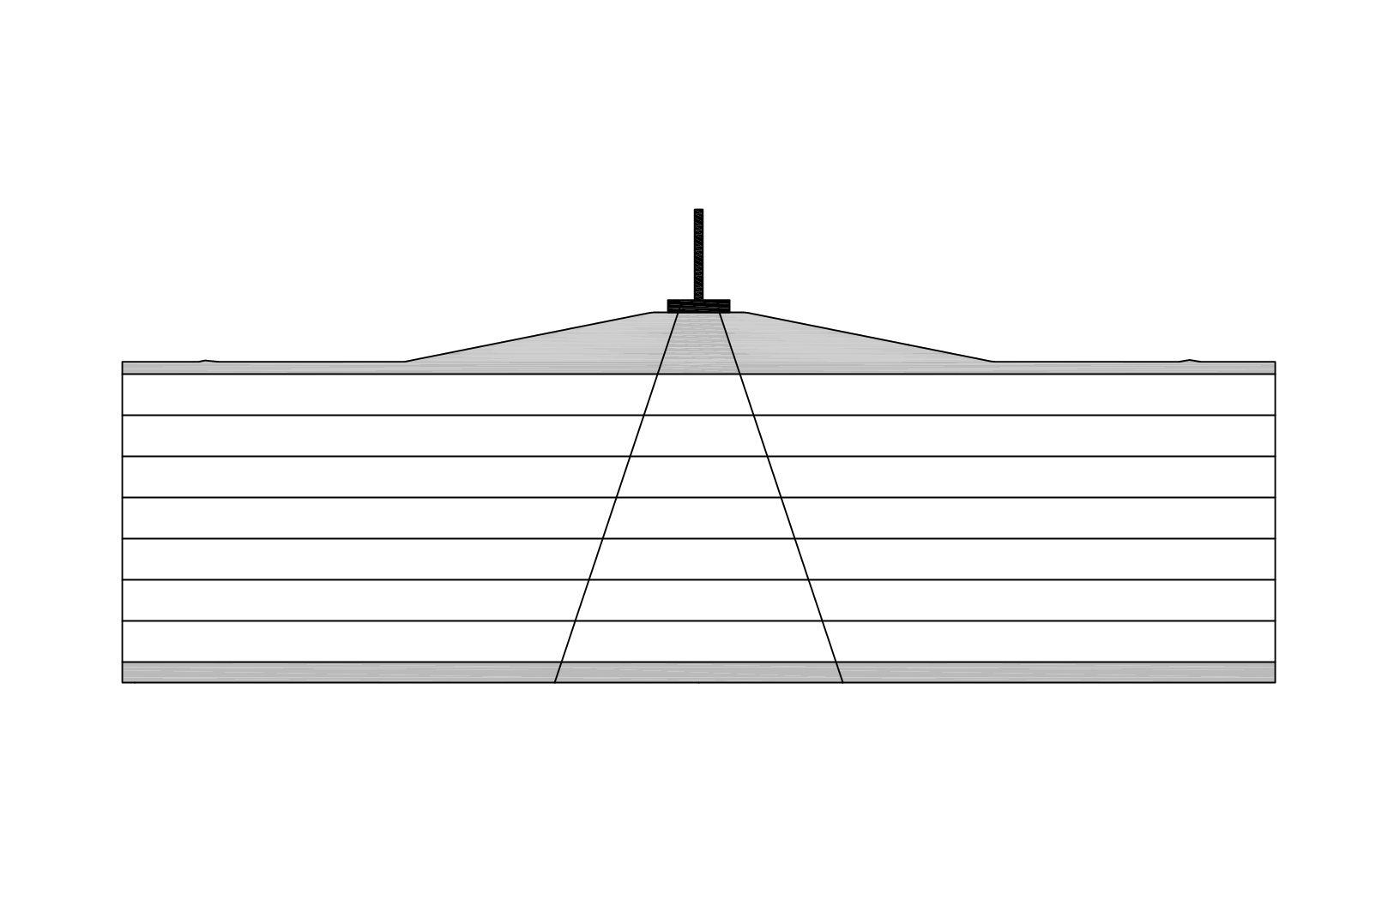
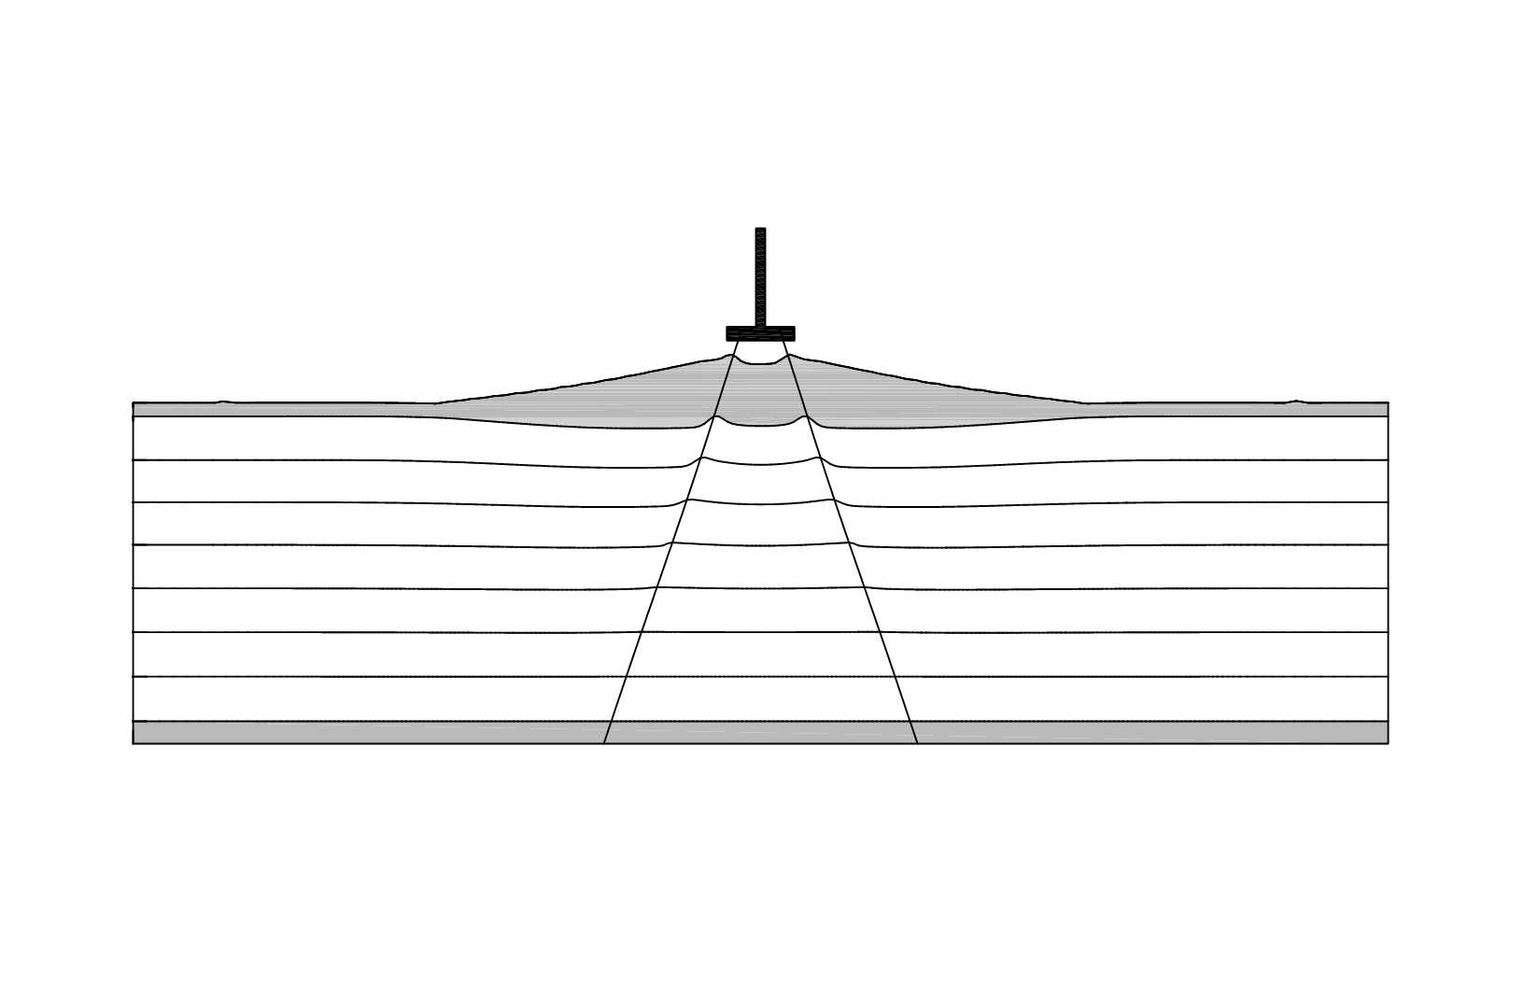
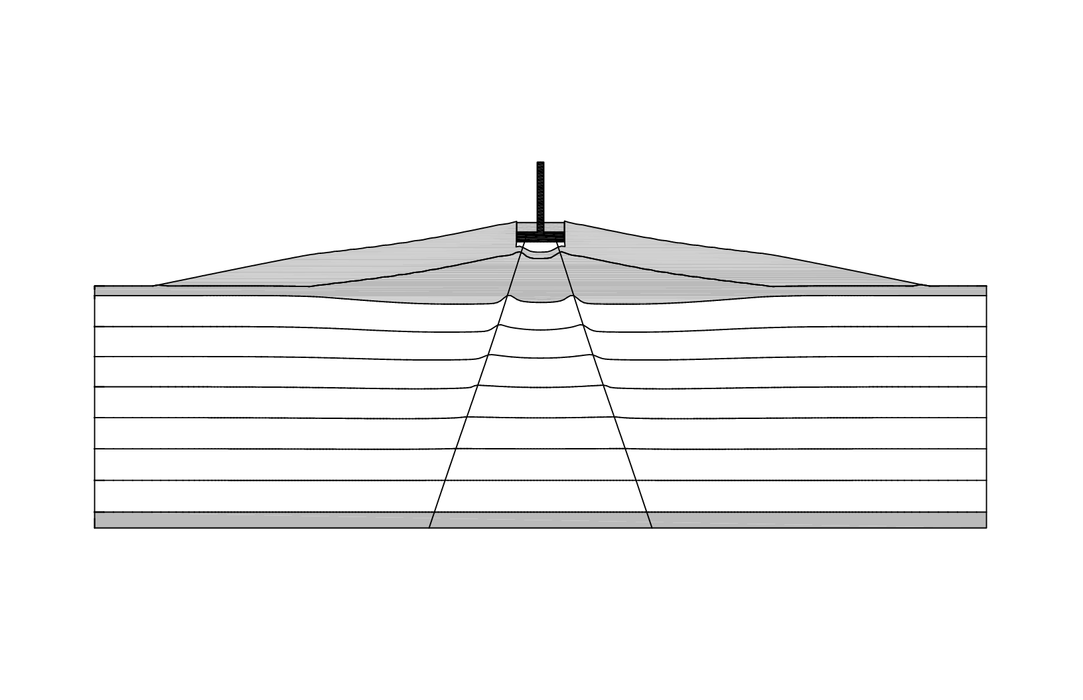
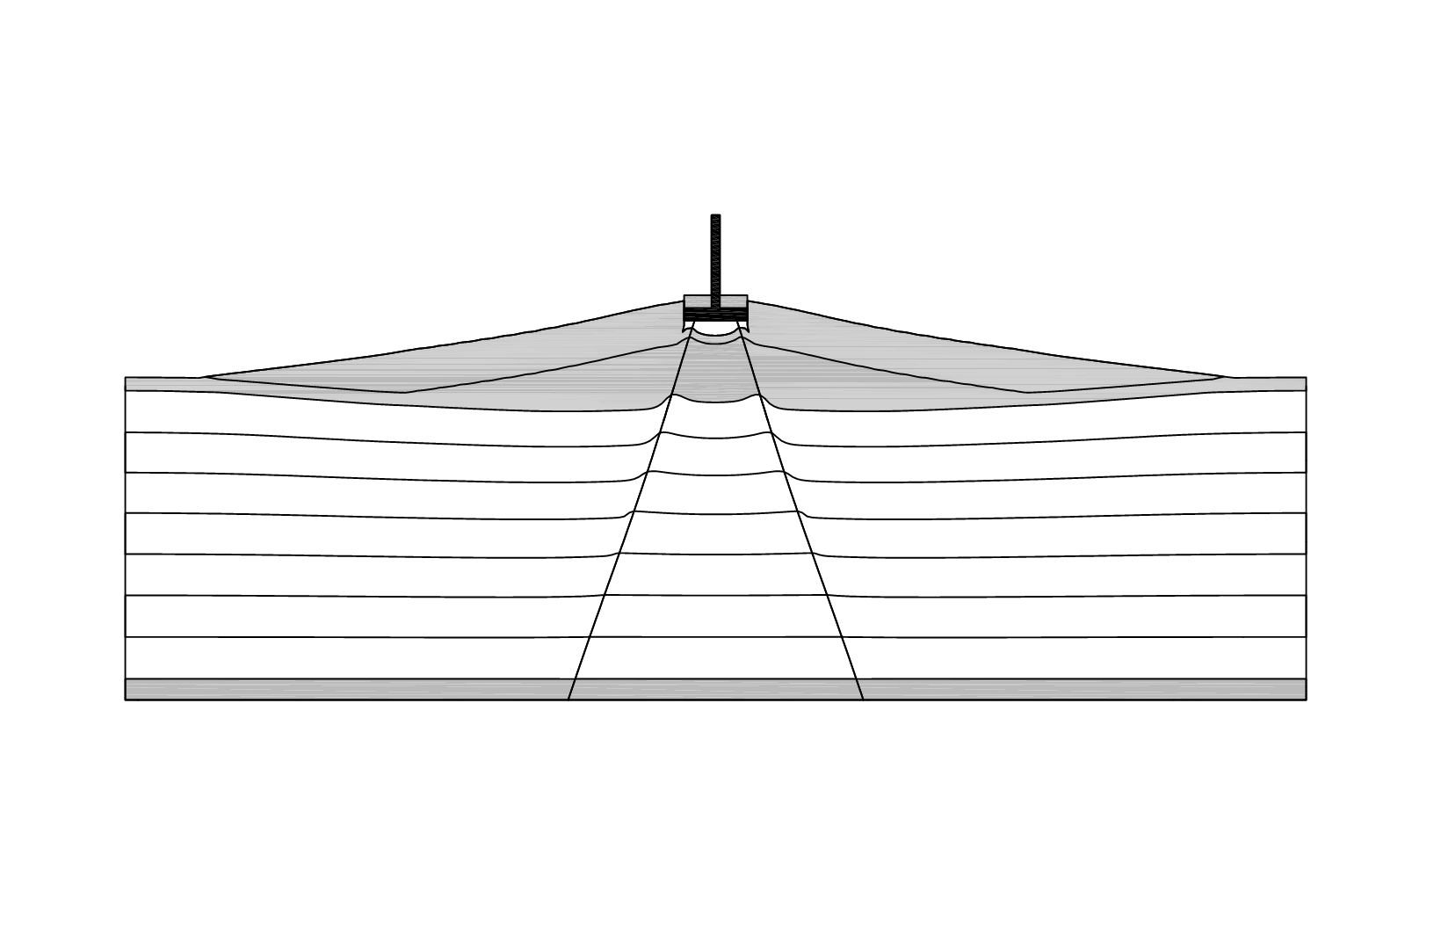
Run 2
T-Wall
Sand Fill (El 25 ft)
Sand Fill (El 15 ft)
Sand
Piles
Clay
Notes:
Pile-soil coupling springs
Grid description
Large-strain mode
Rezoning logic

Slide 11
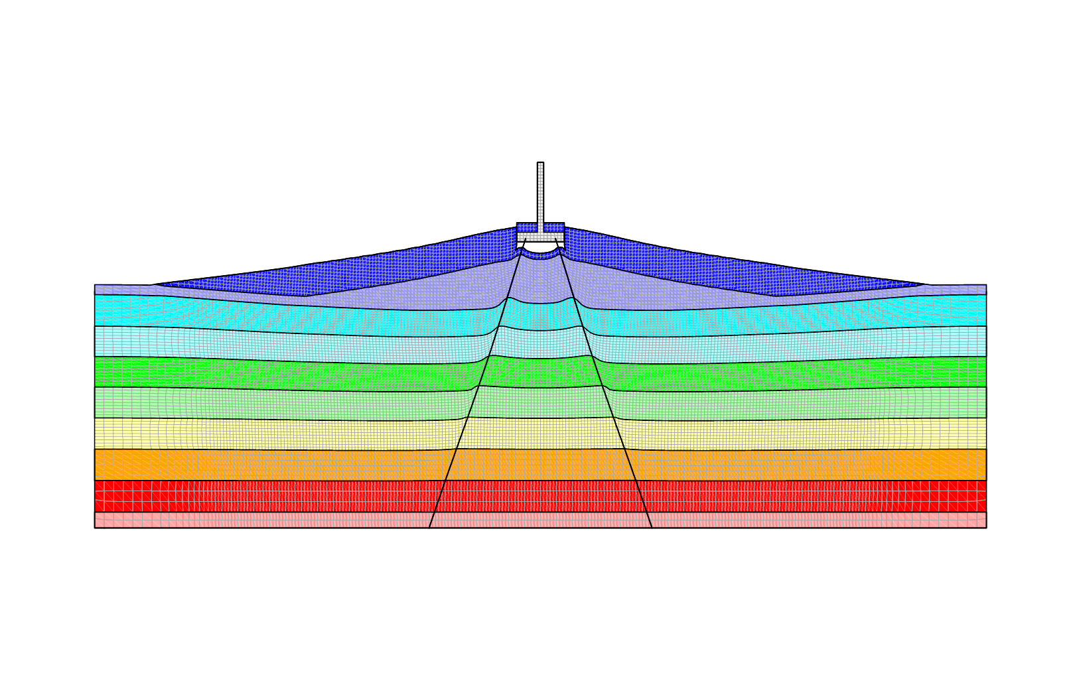
Run 2
T-Wall
Sand Fill (El 25 ft)
Sand Fill (El 15 ft)
Sand
Piles
Clay
Notes:
Pile-soil coupling springs
Grid description
Large-strain mode
Rezoning logic

Slide 12
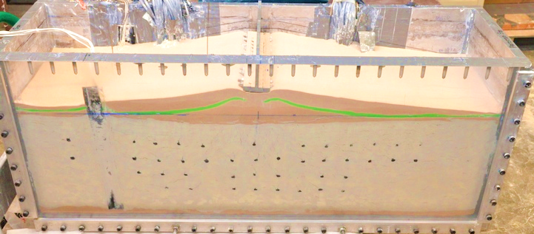
Run 2 – Final Configuration
Sand Fill (El 25 ft)
Sand Fill (El 15 ft)

Slide 13
Numerical Modeling Details
Large-strain
Grid updated based on calculated deformations
Separate grid for T-wall and soils
Allows soil to settle past T-wall
Rezoning logic
Prevents “bad geometry” errors due to large-strain by regenerating mesh as needed
Pile elements
Discrete beam elements “float” on top of soil grid, and interact with grid through pile-soil coupling springs
Springs are elastic, perfectly plastic and based on p-y curves
Pile and spring properties scaled based on spacing

Slide 14
Numerical Modeling Details (contd)
Soil constitutive models
Elastic, perfectly plastic with a Mohr-Coulomb failure criterion for all soils
Clay modulus values calculated and updated based on compression indices, stresses, and Poisson’s ratio value (accounts for nonlinearity)
Additional loading
After settlement calculations, flood or other loading can be applied in the analysis
Soil constitutive models and property values can be updated to those better suited for short-term loading conditions

Slide 15
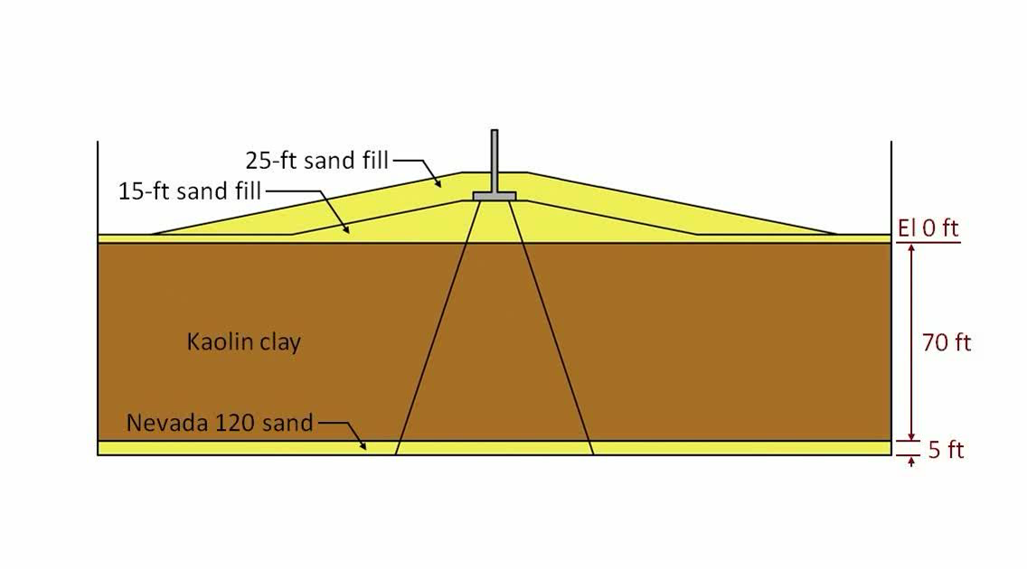
Run 2 – Numerical Modeling

Slide 16
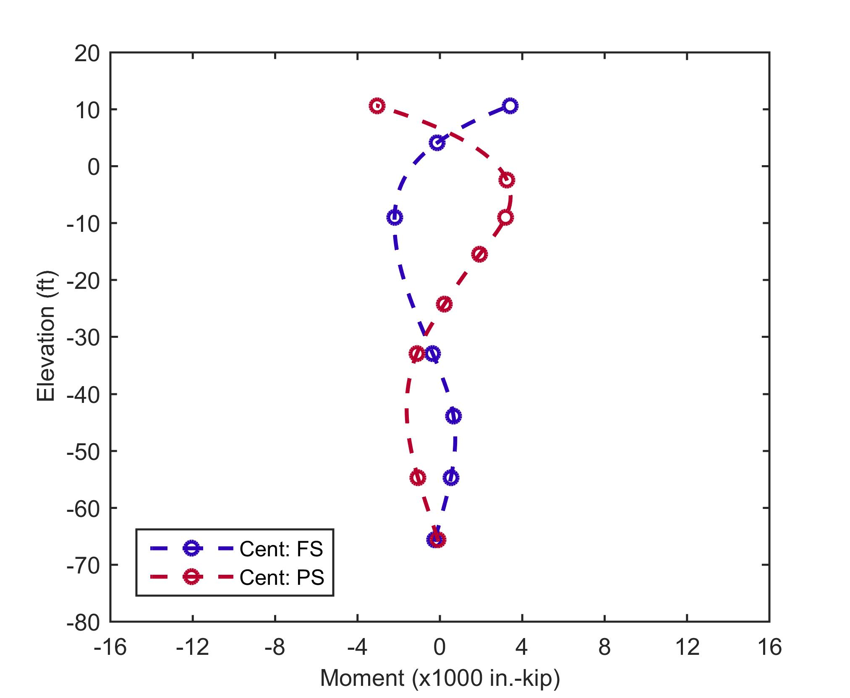
Run 2 – 15-ft Symmetric Fill
Notes:
Here are the bending moments measure in the centrifuge due to the symmetric 15-ft of fill. This is shown of the right.
Blue line represents the FS pile and red is the PS pile. The markers indicate strain gauge locations, and the dashed line is just a spline interpolation between measured values.
Thinking about the mechanics, the bending moments around El -10 ft indicate the piles bowing inwards due to settlements.
The centrifuge tests all had fixed pile connections, and so the piles curvature goes in the other direction at the pile tops, as the piles comply with the fixed, rotational restraint.
Symmetric fill loading results in symmetric bending moments.

Slide 17
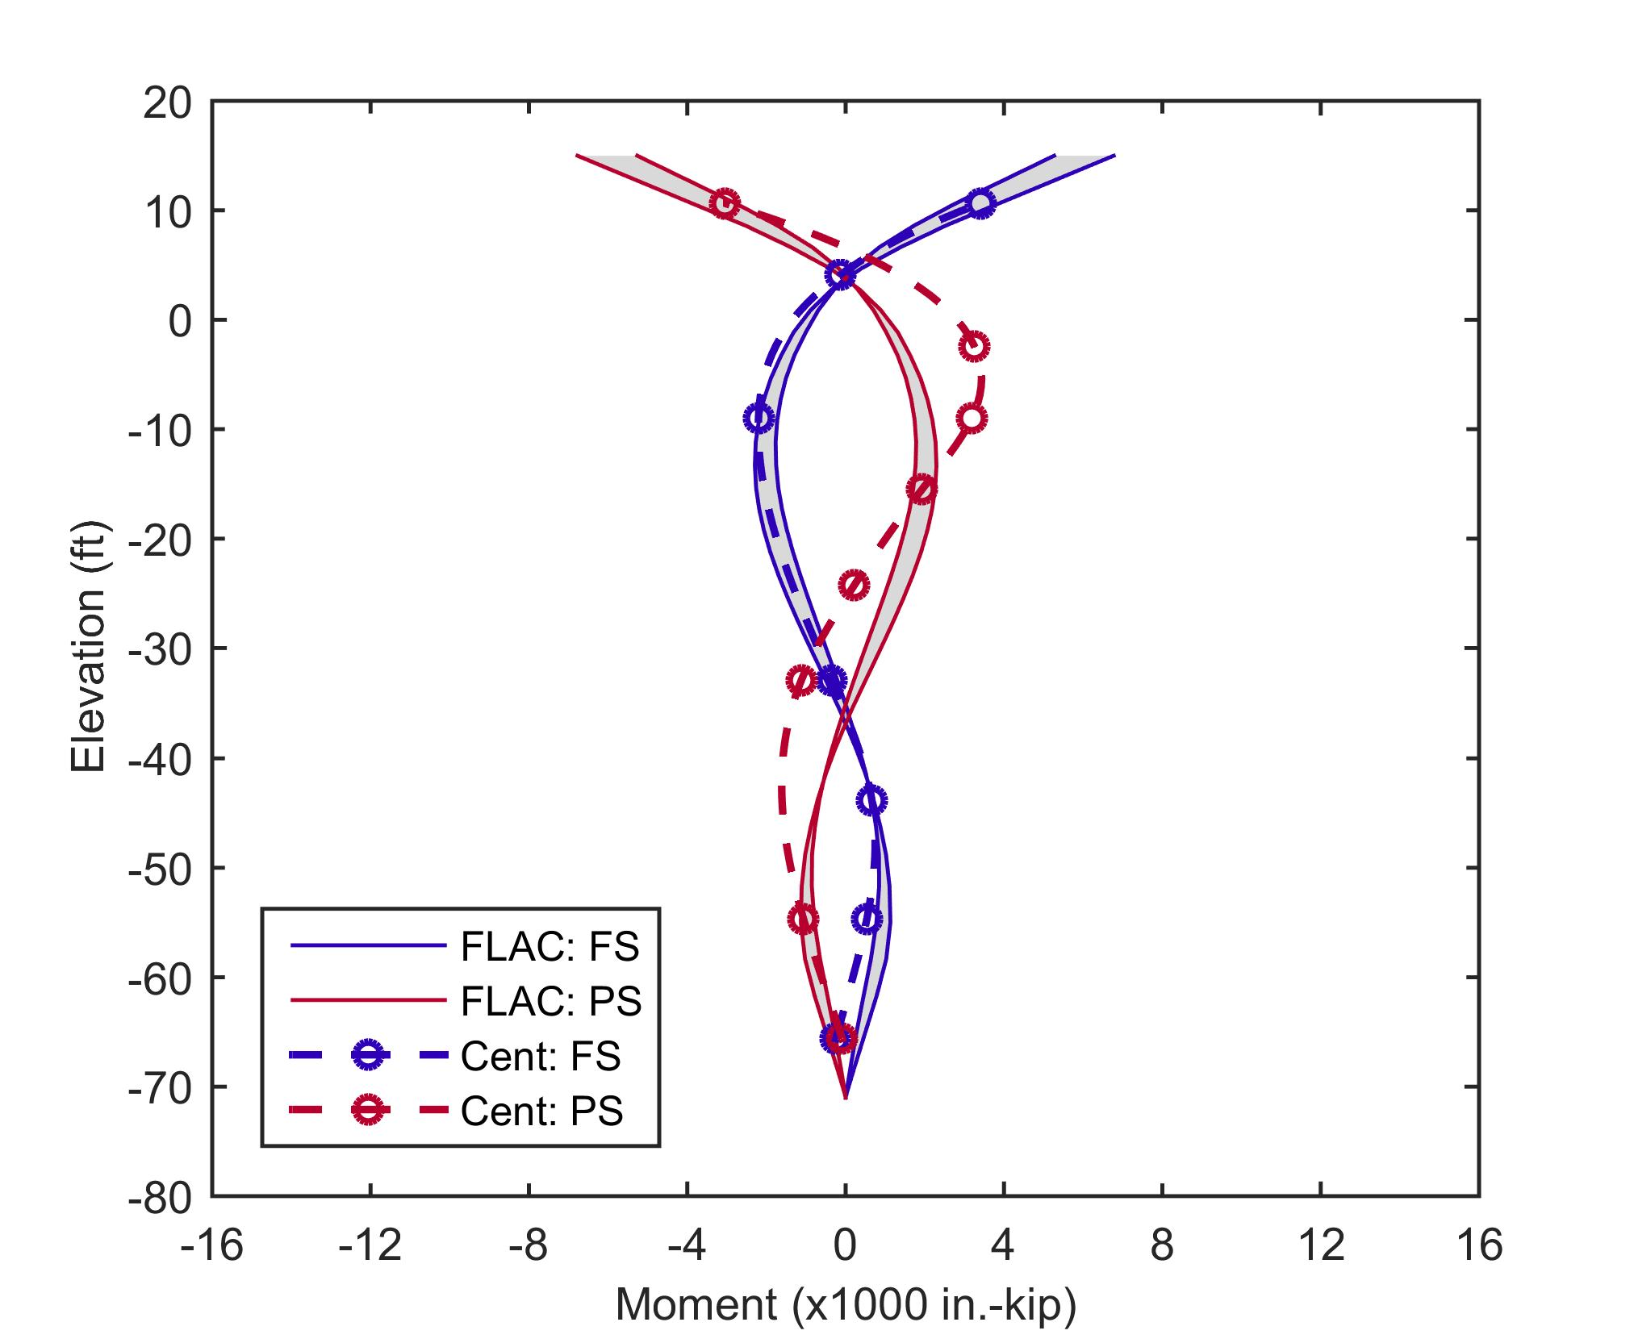
Run 2 – 15-ft Symmetric Fill
UB Stresses
LB Stresses
LB Stresses
Notes:
I analyze this test numerically using the 2D finite difference program FLAC. Because there is variability in the centrifuge and uncertainty in some of the measurements, I assigned lower bounds and upper bounds to my estimates of initial stresses and preconsolidation pressures. The results ranges of moments are shown by the thin solid lines and the shading in this plot
The lower bound values give larger settlements and moments, and upper bounds give smaller settlements and moments
As you can see, there is good agreement between the centrifuge and numerical model results.

Slide 18
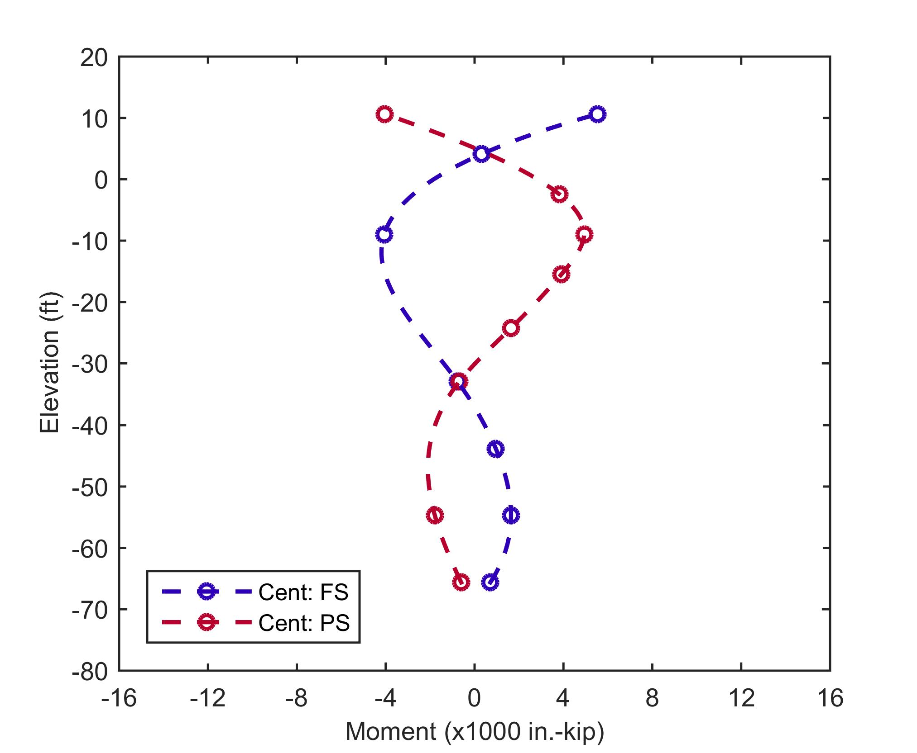
Run 2 – 25-ft Symmetric Fill

Slide 19
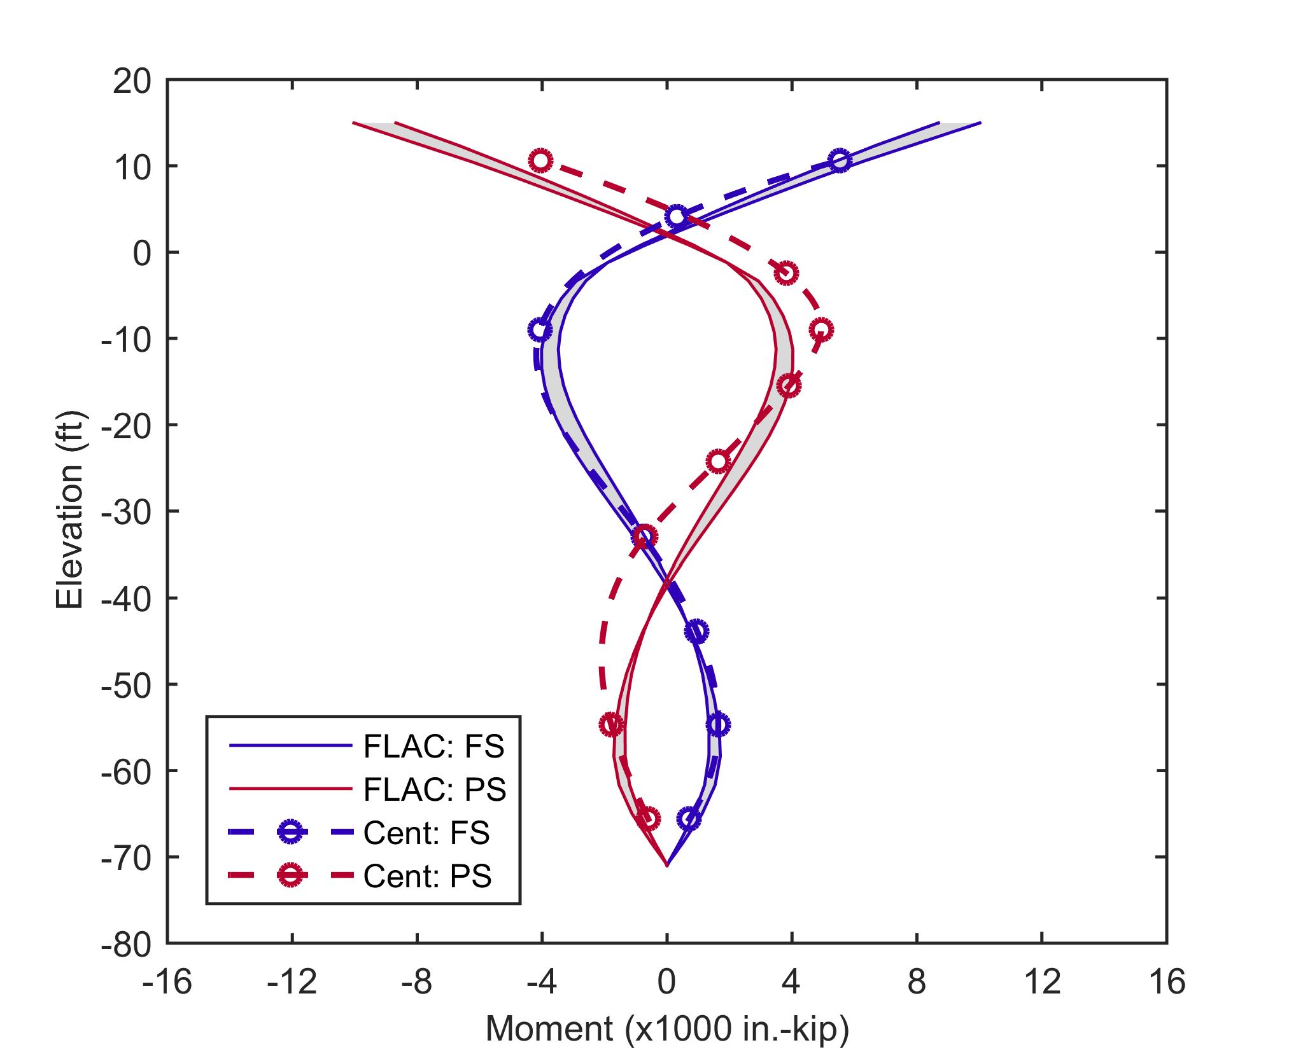
Run 2 – 25-ft Symmetric Fill
UB Stresses
LB Stresses
LB Stresses

Slide 20
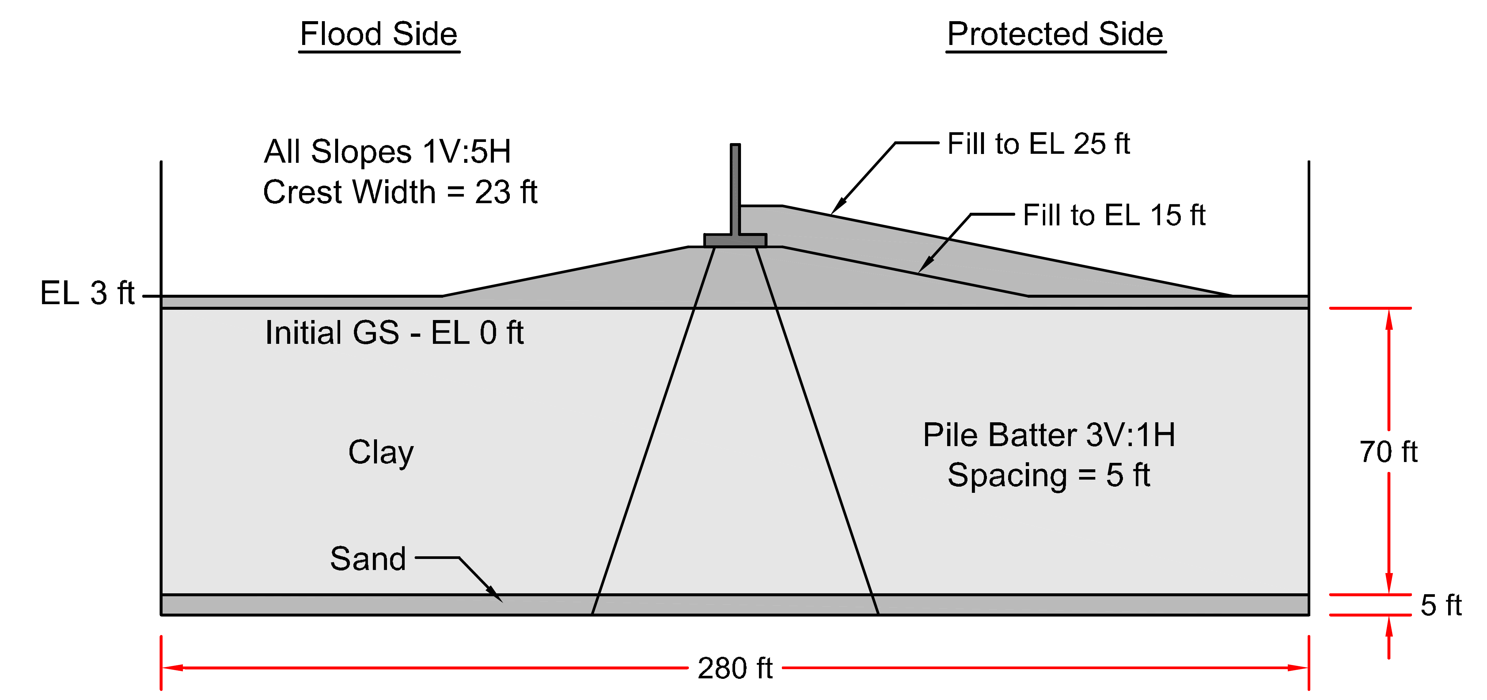
Run 5 – Centrifuge Test
LVDT
30 ft
Notes:
If we looked through that clear acrylic face, this is about what we would see for centrifuge Run 5.
For this run, RPI first prepared the clay foundation soils. Then they added the 15-ft symmetric fill and installed the T-wall on top. They spun the model in the centrifuge to allow consolidation settlement to occur, and recorded settlements and moments. Then they added 10 more feet of fill to PS and spun the centrifuge back up to allow additional settlement to occur, and again recorded settlement and moments.
Also, I want to mention that test box was 4 ft long, and about a foot and a half tall. RPI performed the tests at 70g, and so this 4 ft long model actually represents and behaves in the centrifuge like a 280 ft long cross section.
LVDT on both sides of wall
8 tests total, with different variations:
2 or 3 piles, T-wall base at 0 or 15 ft, symmetric vs asymmetric fill
One test with 1) fill of broad lateral extent, 2) Pile spacing of 10 ft instead of 5 ft
All had fixed pile to T-wall connections.

Slide 21
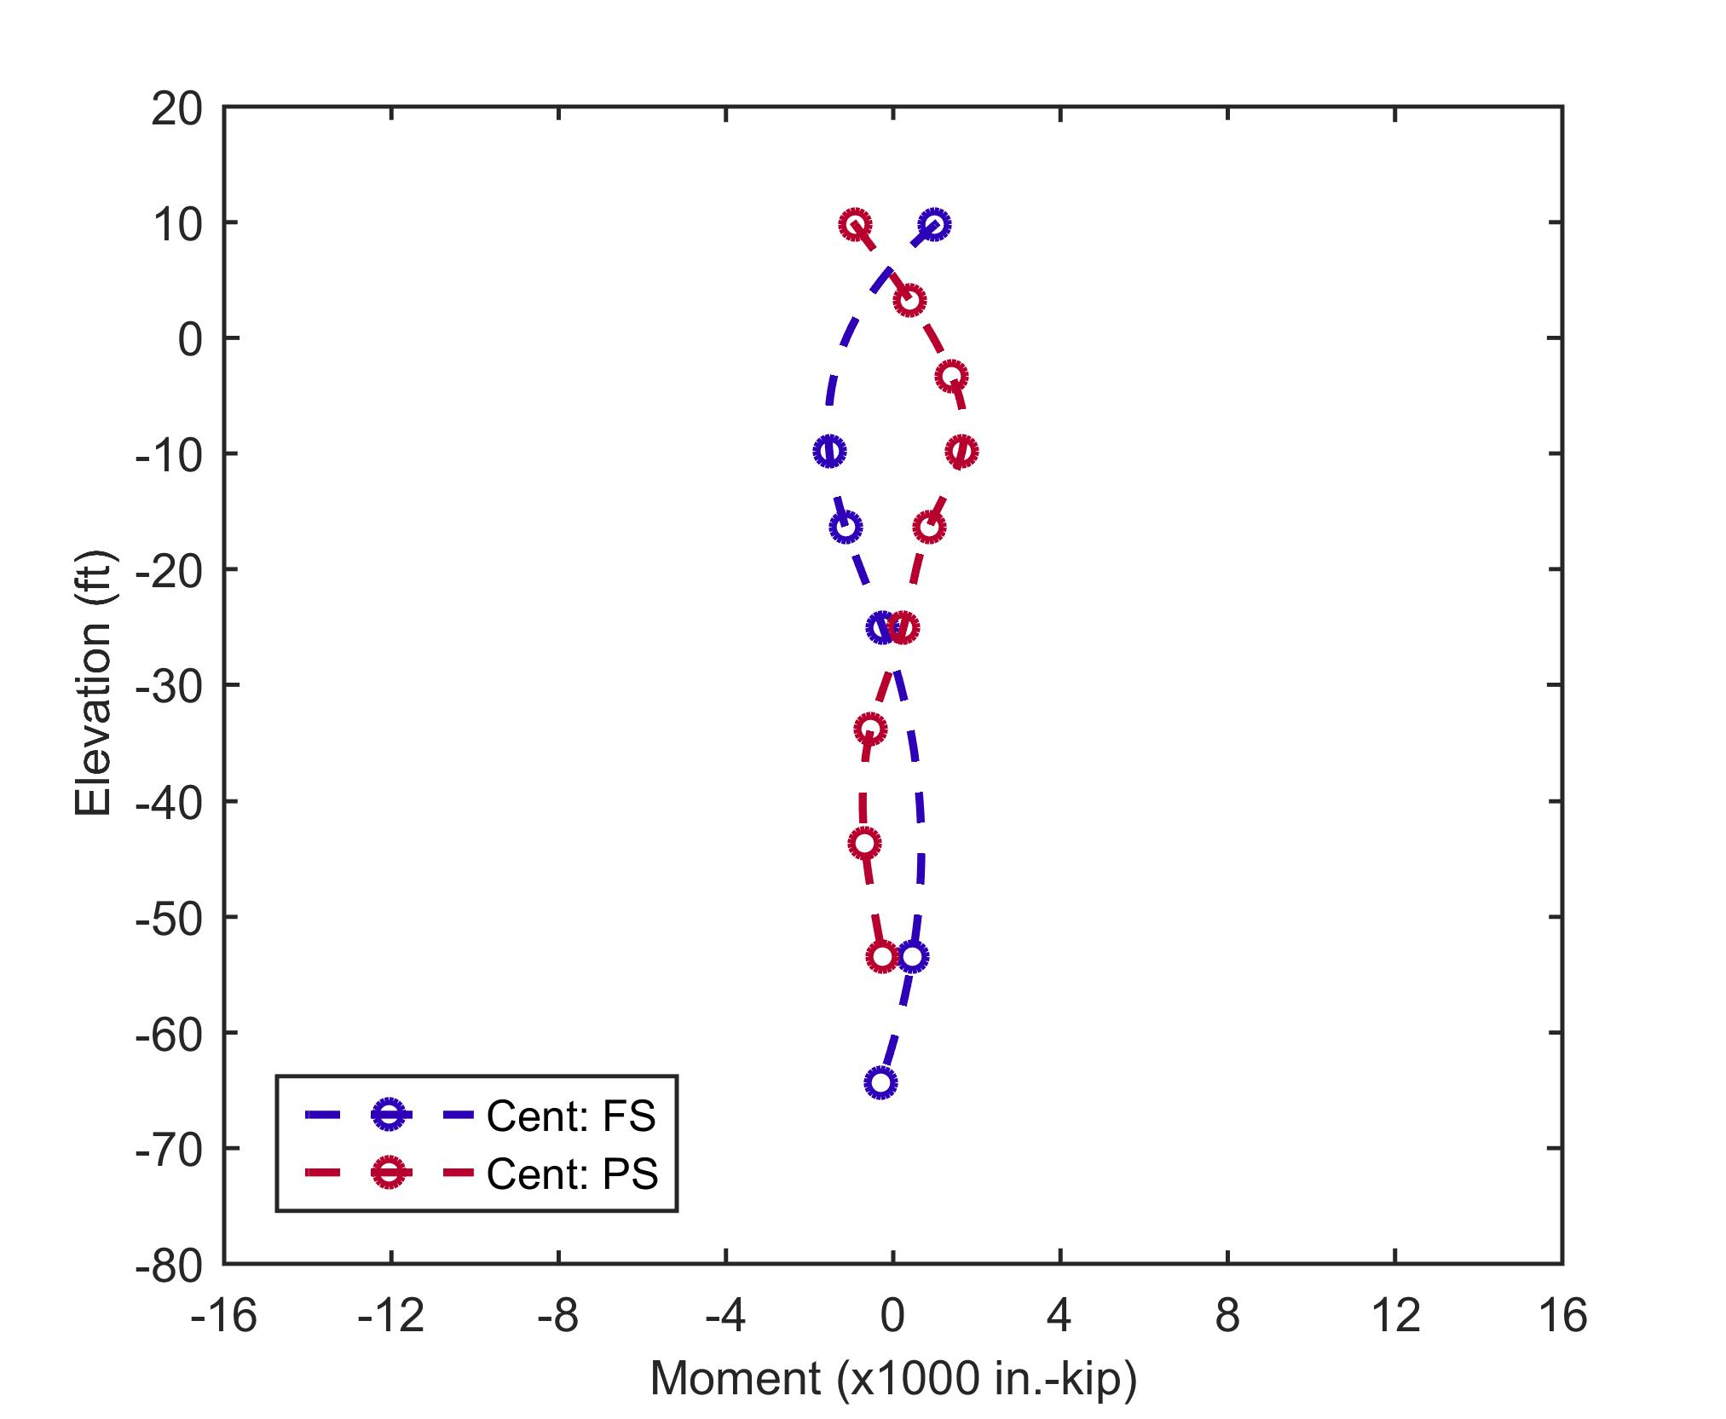
Run 5 – 15-ft Symmetric Fill
Notes:
Here are the bending moments measure in the centrifuge due to the symmetric 15-ft of fill. This is shown of the right.
Blue line represents the FS pile and red is the PS pile. The markers indicate strain gauge locations, and the dashed line is just a spline interpolation between measured values.
Thinking about the mechanics, the bending moments around El -10 ft indicate the piles bowing inwards due to settlements.
The centrifuge tests all had fixed pile connections, and so the piles curvature goes in the other direction at the pile tops, as the piles comply with the fixed, rotational restraint.
Symmetric fill loading results in symmetric bending moments.

Slide 22
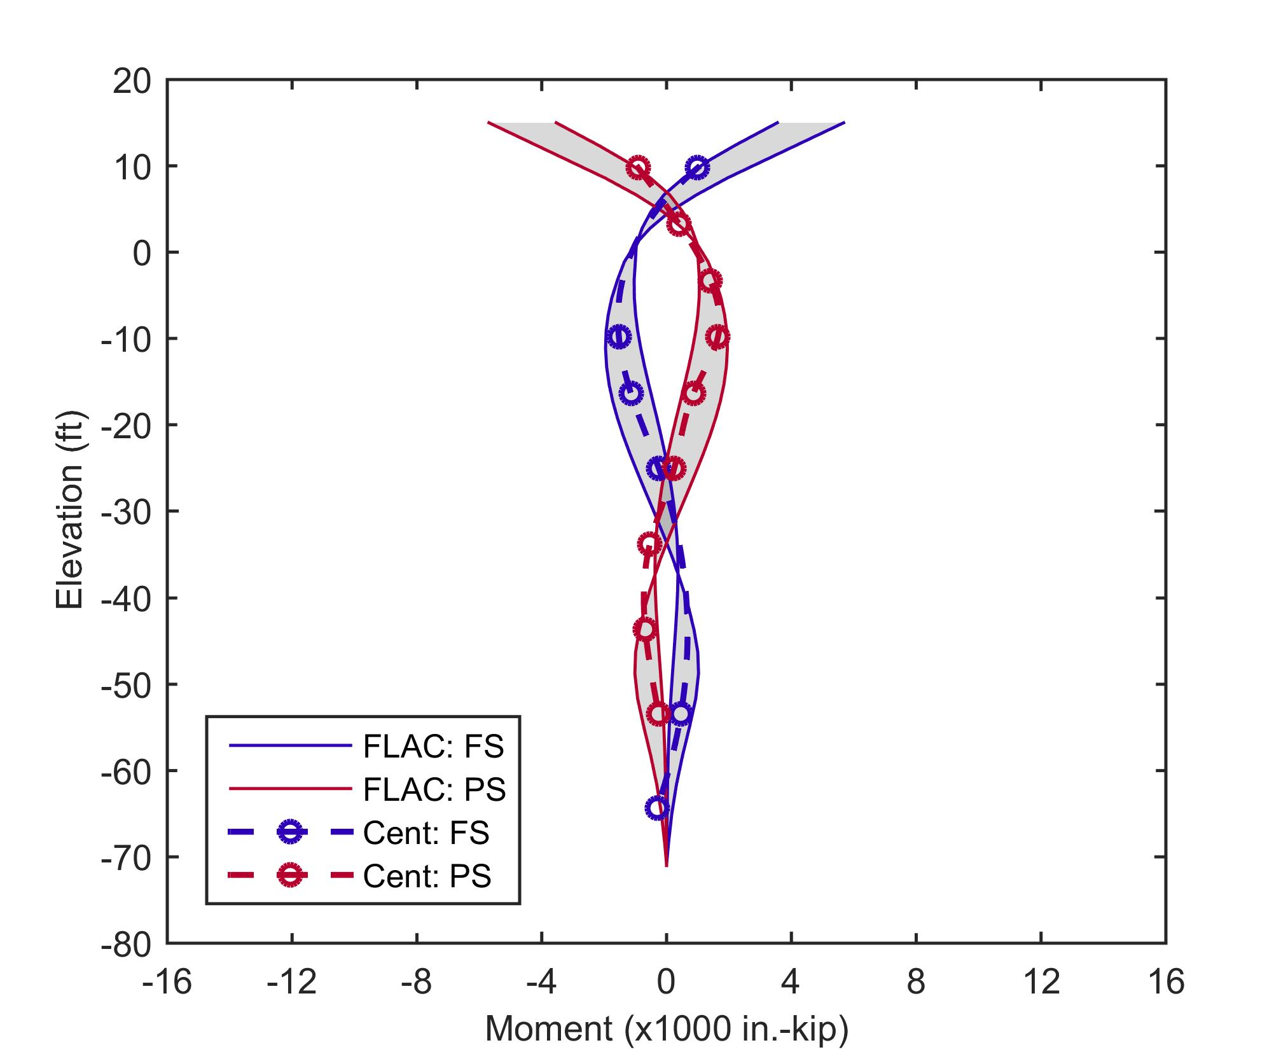
Run 5 – 15-ft Symmetric Fill
UB Stresses
LB Stresses
LB Stresses
Notes:
I analyze this test numerically using the 2D finite difference program FLAC. Because there is variability in the centrifuge and uncertainty in some of the measurements, I assigned lower bounds and upper bounds to my estimates of initial stresses and preconsolidation pressures. The results ranges of moments are shown by the thin solid lines and the shading in this plot
The lower bound values give larger settlements and moments, and upper bounds give smaller settlements and moments
As you can see, there is good agreement between the centrifuge and numerical model results.
PS and FS settlement the same and symmetric
30 ft away from the T-wall, settlement ranged from 1.5 ft (upper bound ini stress, precon) to 3.5 ft (lower bound)

Slide 23
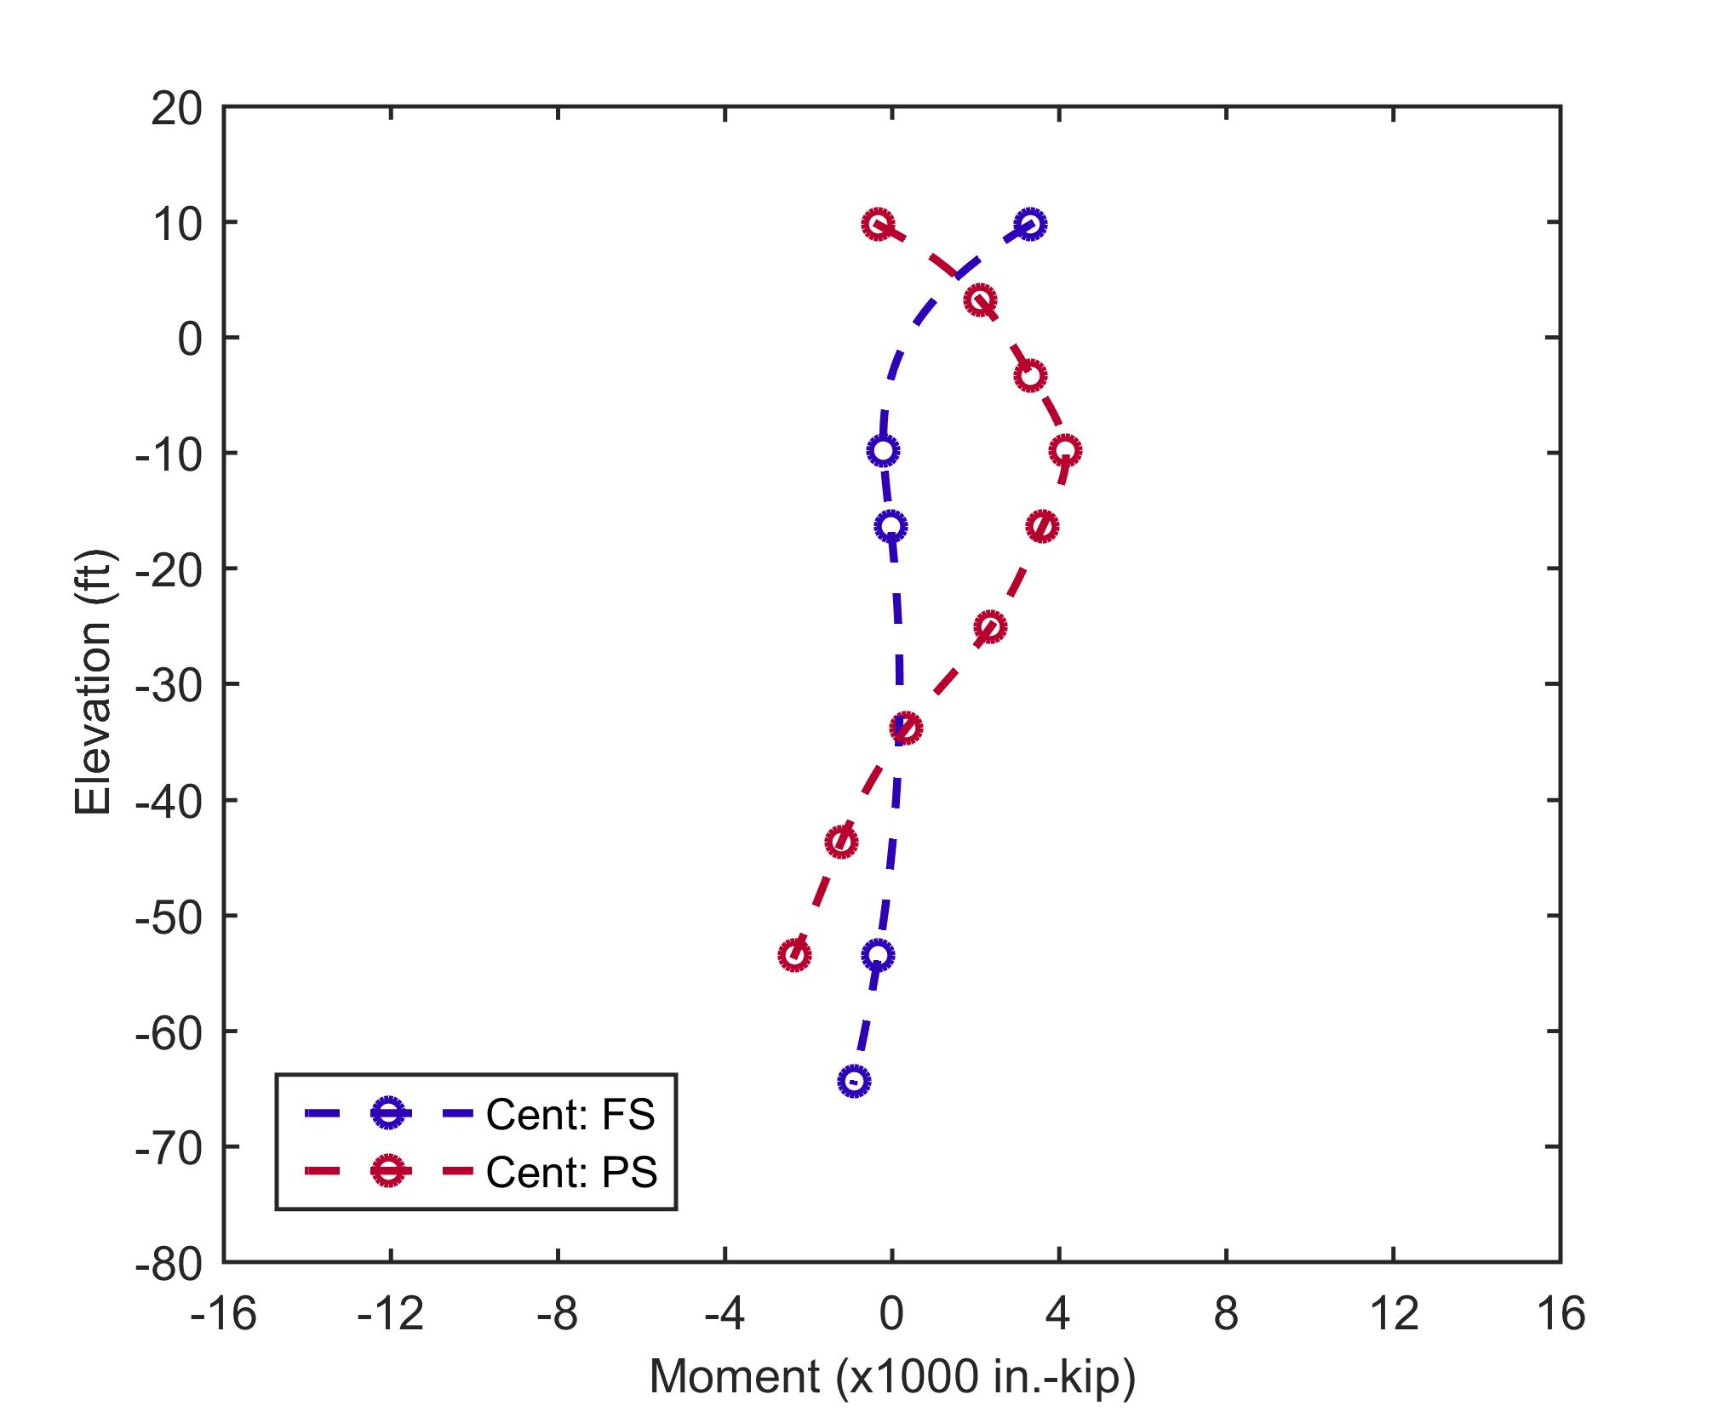
Run 5 – 25-ft Protected-Side Fill
Notes:
Next, 10 more ft of fill was added to the PS.
For the PS pile, this fill loading produces additional settlement loads on the pile that result in larger bending moments at about El -10 ft.
However, the loading on the PS tends to cause horizontal movement of the foundation soils towards the FS, and this “unbends” the FS pile, reducing the moment at around EL -10 ft.
Another complication, is that the PS loading pushes the T-wall towards the FS. This tends to reduce the moments at the top of the PS pile and increase the moments at the top of the FS pile.
So both of these mechanisms are influencing the pile response to the additional fill loading.

Slide 24
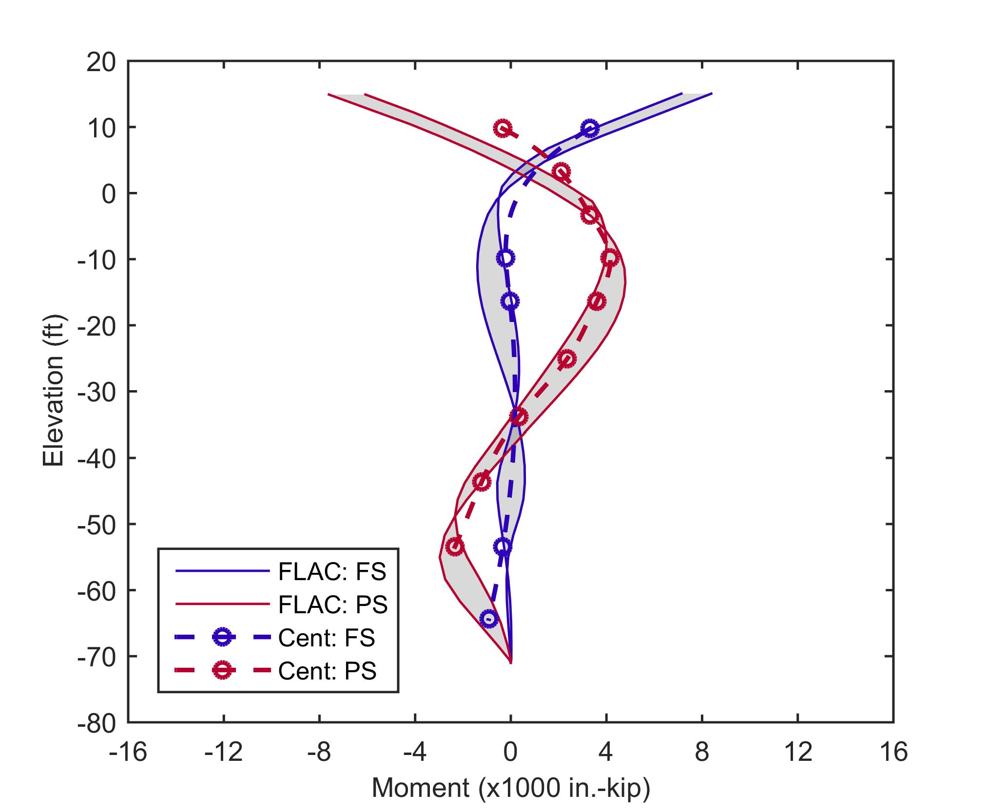
Run 5 – 25-ft Protected-Side Fill
UB Stresses
LB Stresses
LB Stresses
Notes:
Again, I analyzed this cross section numerically with lower bound and upper bound estimates of initial stresses and preconsolidation pressures.
And you can see that there was good agreement with the results.
Overall there was similarly good agreement between all eight of the centrifuge tests and the numerical models, and this was true without the need to perform any significant calibration of the numerical models.
These results gave us confidence that the numerical models could be used to analyze actual T-wall cross sections in the field.
Additional PS fill and no FS fill
30 ft away from the T-wall, on FS, settlement ranged from .25 ft (upper bound ini stress, precon) to .5 ft additional (lower bound)
30 ft away from the T-wall, on PS, settlement ranged from 1.5 ft (upper bound ini stress, precon) to 2 ft additional (lower bound)

Slide 25
Summary
Centrifuge tests provided high quality experimental data on settlement-induced bending moments for a variety of pile and fill loading configurations
Numerical models show very good agreement with centrifuge tests for all 16 comparisons
Validated numerical modeling approach was developed for pile-supported T-walls, but similar approach can be used for analysis of other batter pile applications:
Bridge abutments
Retaining walls
Wharfs

Slide 26
Thank you!

